Slide 1
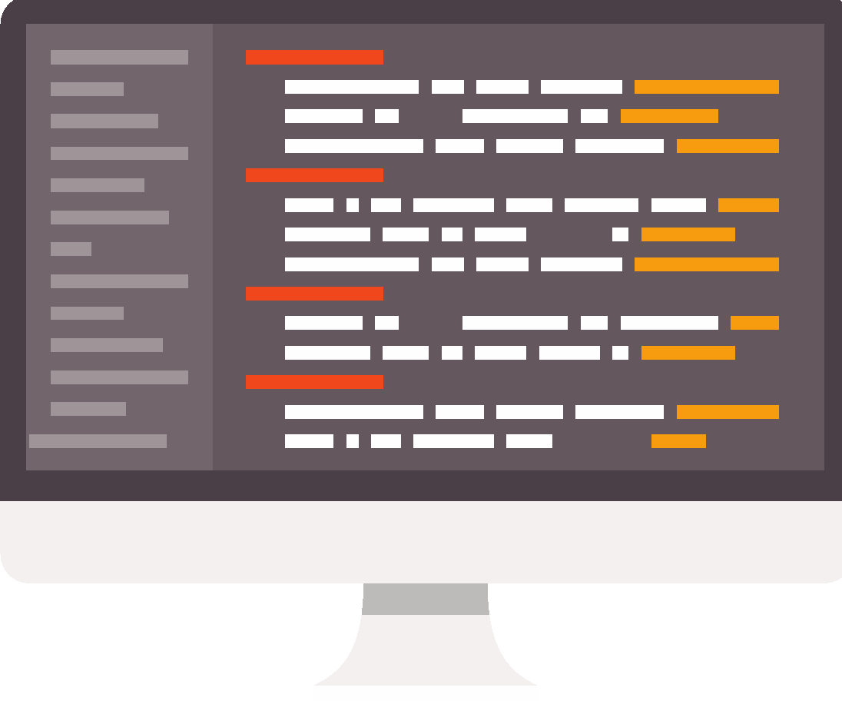
Programming in Scratch
Lesson 3: Using variables

Slide 2
Objectives
In this lesson, you will learn how to:
input and output data using Scratch
define the term ‘variable’
use variables to temporarily store data in Scratch
apply concatenation to join strings and variables.

Slide 3

What do you already know?
Activity 3.1: Using variables in calculations
Now complete Interactive quiz 3.1.

Slide 4
Variables
A variable is a container that temporarily holds a value (a number or a piece of text). The value can be retrieved within the program using its variable name.
This is very similar to cell references in spreadsheets, where you refer to the cell reference instead of the value in the cell.
Using variables means that, if the value changes, you do not have to rewrite your code because it updates automatically.
The content of a variable can change as the program runs, so it might not always stay the same.

Slide 5
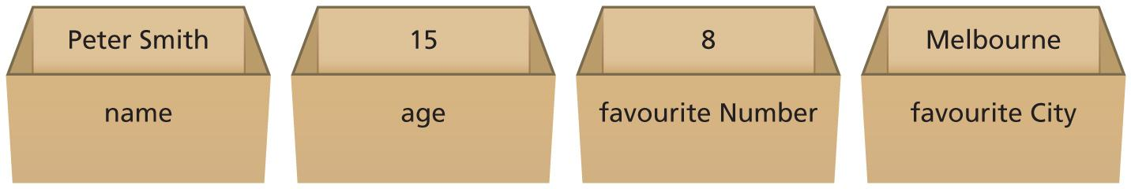
Understanding variables
Think of a variable as a box with a name, which contains a piece of information. You do not need to know what is in the box, but you can ask the program to display what is in the box by referring to its name.

Slide 6
Variables in Scratch
Now watch Video 3.1

Slide 7
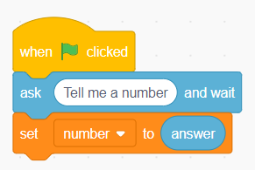
New blocks
Here are some of the new blocks that you will need to use to work with variables in Scratch.
The ‘ask’ block displays a message and you can customise what it says in the white area. This block requires a response from the user. The user has to type something in; enter an input.
The ‘set’ block sets your chosen variable to something. You have to create your variable first, in the ‘Variables’ category of the palette. In this example, the variable number is set to the answer from the question asked in the previous block.

Slide 8
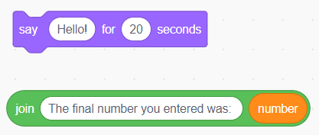


New blocks
The ‘say’ block makes the cat say whatever is in the white area for as long as you specify.
The ‘join’ block is used to join text together with variables. This is called concatenation.
You can combine the ‘say’ block and the ‘join’ block. This line of code would output The final number you entered was: and then the value that is stored in the number variable.
Multiple ‘join’ blocks can be used to join together multiple strings and variables.

Slide 9
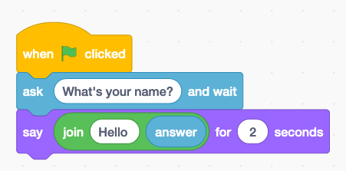
New blocks
When the ‘ask’ block is used, it automatically creates a variable called ‘answer’ that stores whatever is entered by the user.
This means that, if you want to output the answer straight away, you don’t need to create a variable.

Slide 10
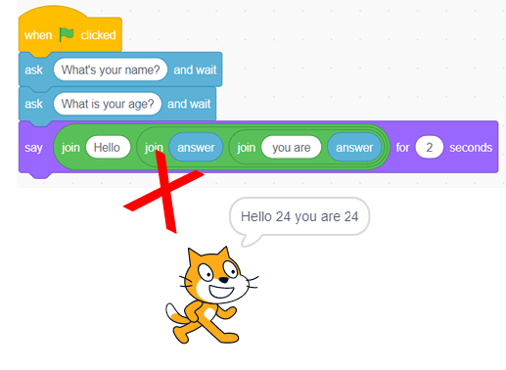
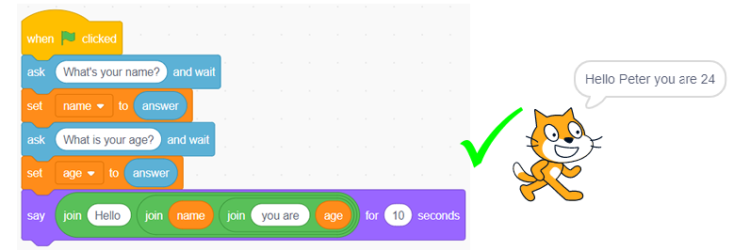
However, if you want to ask multiple questions and output the information entered by the user at a later date, you will need to create a separate variable for each question and set it to the corresponding answer.
Compare these two programs:

Slide 11
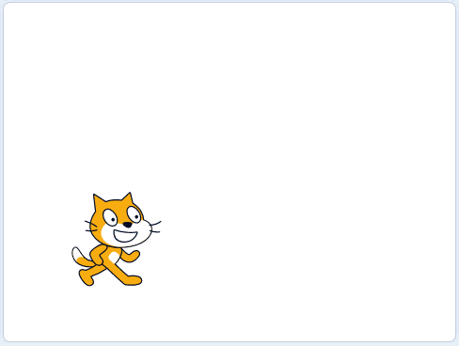
Activity 3.2: Asking your name
Example of finished solution

Slide 12

Activity 3.3: Shopping list
Example of finished solution

Slide 13
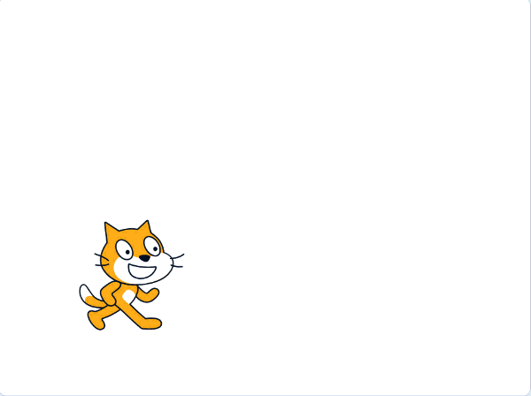

Activity 3.4: Chatbot aka ‘Cat Bot’
Example of finished solution
Example of extension 1

Slide 14
Question 1
What is a variable?

Slide 15

Question 2
In which category would you find the block to display something on screen?

Slide 16

Question 3
In which category would you find the block to ask a question?

Slide 17
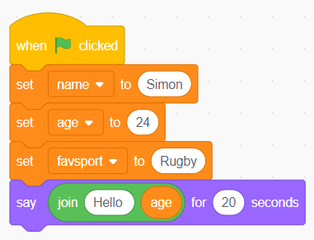
Question 4
What is wrong with this code?

Slide 18
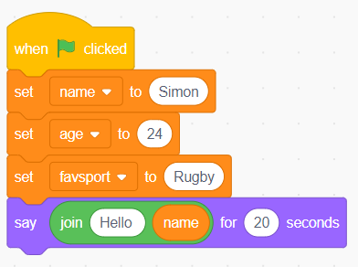
Question 5
How many variables are there in this code? What are the names of the variables?

Slide 19
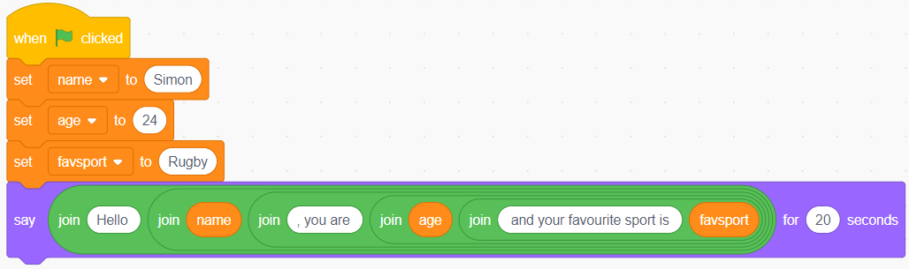
Question 6
What would the cat say on screen when the program is run?

Slide 20
Quiz 3

